Slide 1
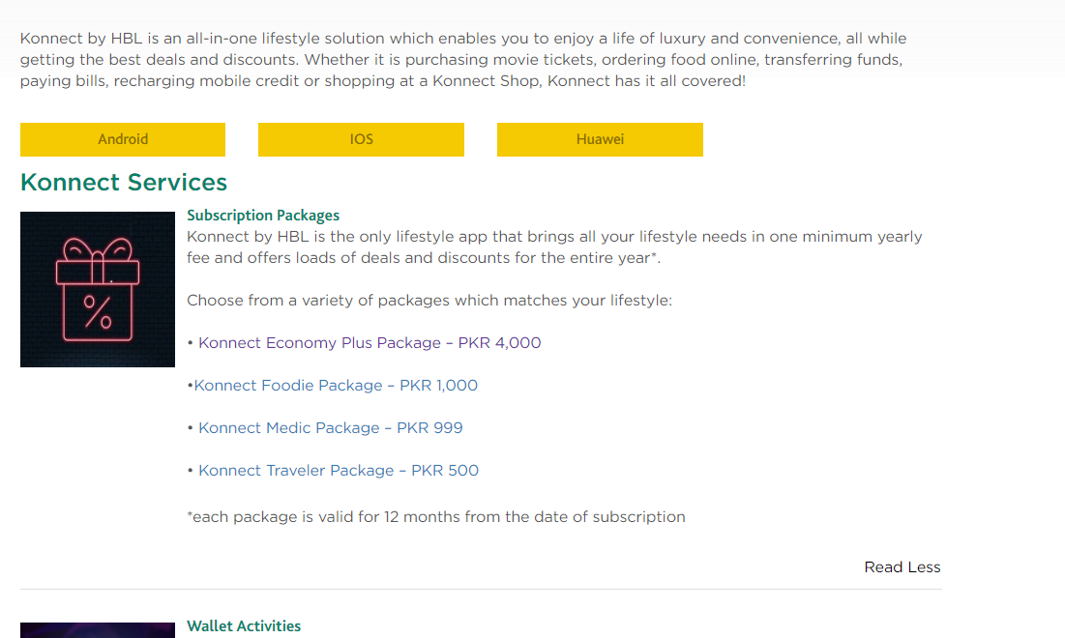
https://www.hbl.com/konnect
Change to: “Konnect Economy Pro Package – PKR 3,100”

Slide 2
https://www.hbl.com/konnecteconomypackage
Change monthly limit to PKR 200,000

Slide 3
Remove all content from this page and replace with the below:
https://www.hbl.com/konnectfoodiepackage
Change link to: /economypropackage
Economy Pro Package - PKR 3,100
Free Cash Deposit & Withdrawal at Agent*
*Monthly limit: PKR 100,000
HBL reserves the right to terminate or withdraw or change the criteria of any discount offering without providing prior notice or reason’

